Slide 1
Computer Vision Project
Update n.2
Road Detection and Segmentation in Dashcam Images
Rava Miro
Sommaruga Tommaso

Slide 2
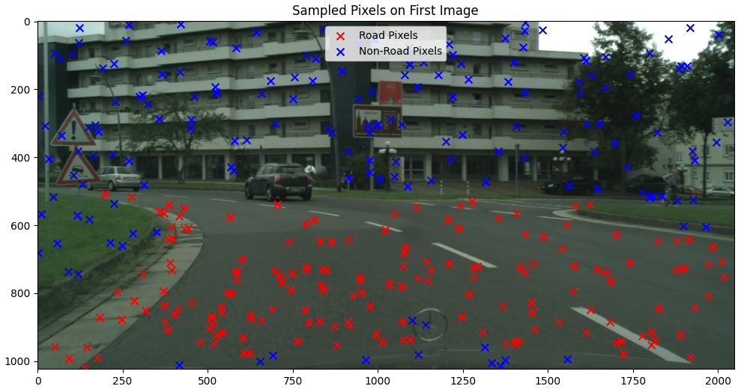
Single Pixel Classifier
Sampling Method

Slide 3
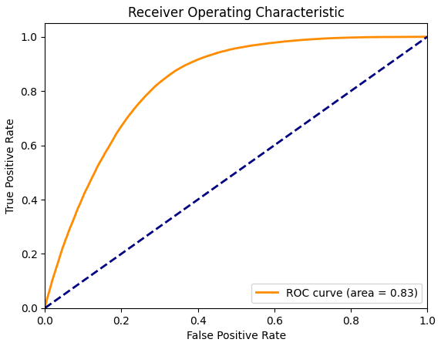
Single Pixel Classifier
ROC Curve

Slide 4
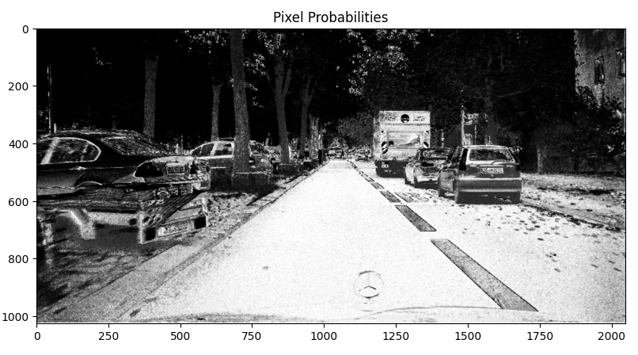
Single Pixel Classifier
Final Classification Result

Slide 5
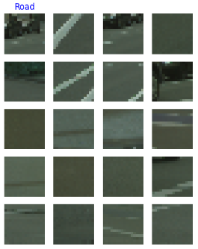
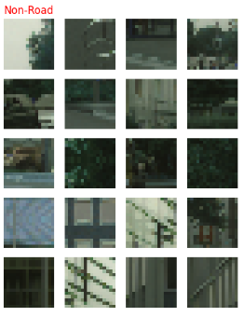
Patch Classifier
Patches Visualization

Slide 6
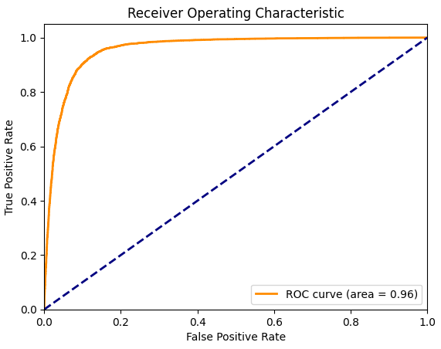
Patch Classifier
ROC Curve

Slide 7
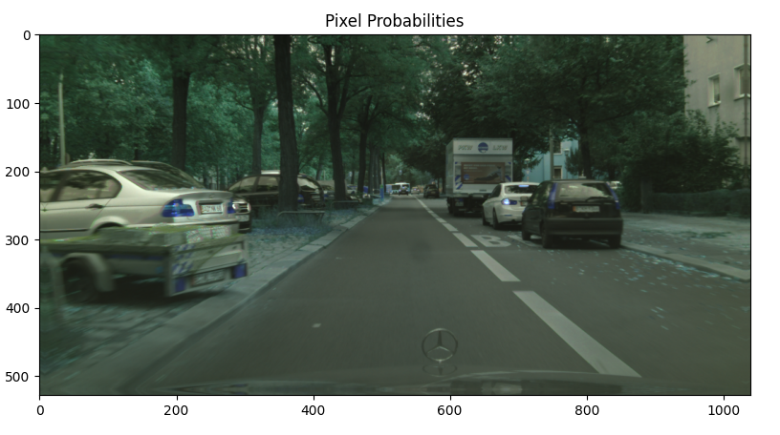
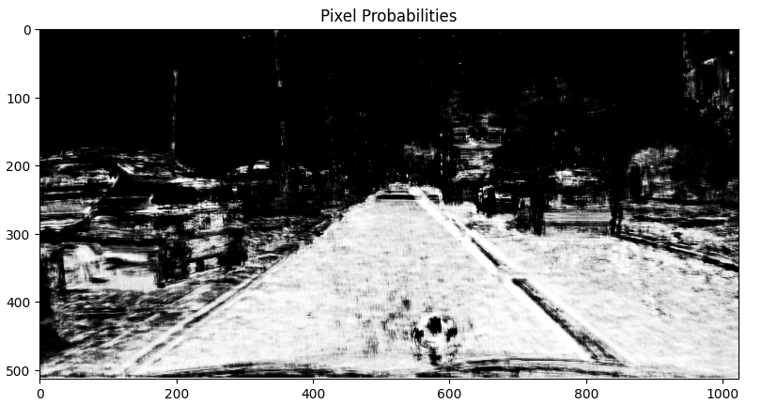
Patch Classifier
Final Classification Result

Slide 8




Thank you
Rava Miro
Sommaruga Tommaso

